Slide 1


Martyn Ben Ami
29th October 2022

Slide 2

Outline
Executive Summary
Introduction
Methodology
Results
Conclusion
Appendix

Slide 3
Executive Summary
Data collection using calls from the publicly available data through the SpaceX API
Web scraping using the SpaceX website for Launch information, putting useful collumns into a Pandas data frame.
Data wrangling by means of filtering data based on mission parameters and outcomes
EDA with SQL using IBM db2 API to store and query data to identify which rockets had more successful missions and which carried the biggest payloads.
EDA with interactive visual analysis using Folium to display in context of the earth where missions were successful and what parameters are requirements for a launchsite i.e proximity to the public and logistical resources
EDA with interactive visual analysis using Dash to be abe toquicklyaccess different information about the launch sites and payloads without having to make a new graph for every paraeter, one can select the reas of interest and get an impression using appropriate visaul tools
Machine learning using scikit-learn to develop, compare select the best predictive model trained and teted on the cleaned and collected data from SpaceX launches
In summary our model can predict launch outcome based on launch site location, payload and rocket used to an accuracy of more than 0.85

Slide 4
Introduction
SpaceY wants to join the spacerace in competition with SpaceX to do that, we have to determine the state of the art and other factors involved to best use the technology.
Goal of this project is to find, sort and use data to determine What factors, when combined resulted in the most successful launch missions for spacex to not have to go through the same trial and error and get a competitive advantage from their efforts. We want to avoid reinventing the wheel.
To do this we will use publicly available historical data and machine learning to build a model that determines which factors are most important for successful launches.

Slide 5

Section 1

Slide 6
Methodology
Executive Summary
Data collection methodology:
Data was collected from the SpaceX website using python, wget and requests libraries.
Perform data wrangling
Data processed using python and put into pandas dataframes then cleaned and organised
Perform exploratory data analysis (EDA) using visualization and SQL
Perform interactive visual analytics using Folium and Plotly Dash
Perform predictive analysis using classification models
How to build, tune, evaluate classification models

Slide 7
Data Collection
Data was collected from the SpaceX website using python, wget and requests libraries
Data collection process followed princple step laid out in flowcharts in the next slide

Slide 8
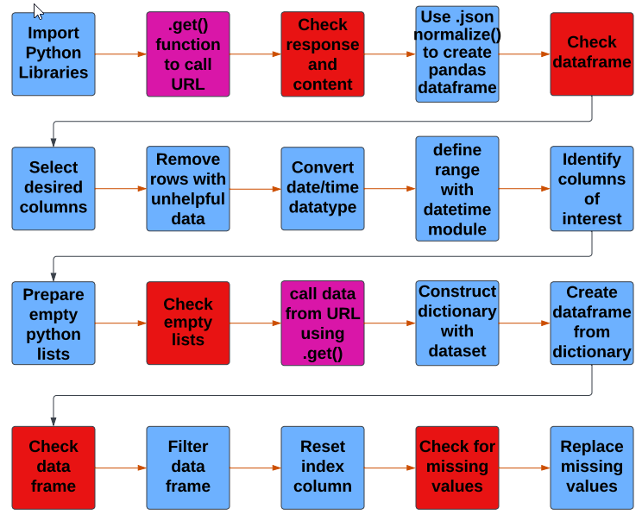
Data Collection – SpaceX API
Present your data collection with SpaceX REST calls using key phrases and flowcharts
https://github.com/Tex6298/SpaceY/blob/main/jupyter-labs-spacex-data-collection-api.ipynb

Slide 9
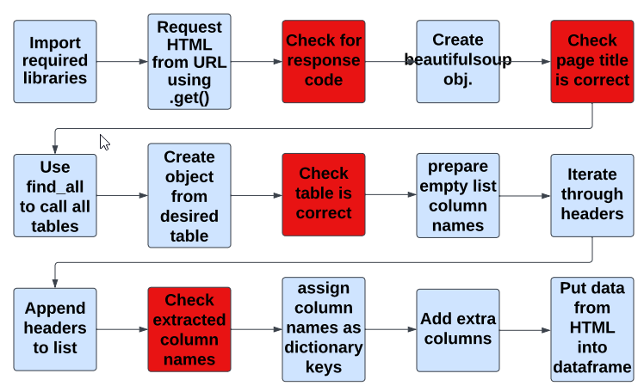
Data Collection - Scraping
Extract a Falcon 9 records table from wikipedia.
Parse the table and convert it into a Pandas data frame.
https://github.com/Tex6298/SpaceY/blob/main/Lab_1b_jupyter-labs-webscraping.ipynb
Place your flowchart of web scraping here

Slide 10
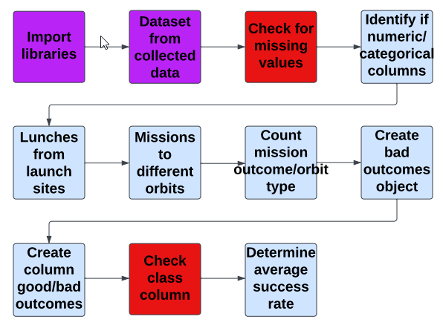
Data Wrangling
Data processed put into pandas dataframes then cleaned and organised for exploratory data analysis and training labels were determined.
https://github.com/Tex6298/SpaceY/blob/main/Lab_2_Data_Wrangling.ipynb

Slide 11
EDA with Data Visualization
Exploratory Data Analysis and Feature Engineering using matplotlib and seaborn.
Produced category graphs and bar graphs demonstrate relationships between launch attempt, launch site, payload, orbit type and mission success.
Category graphs are used to compare two variables directly while simultaneously showing a third categorical variable as colour. This makes it obvious if a combination of variables frequently resulted in a succesful mission or not.
Bar graphs are good for comparing how often variables resulted in successful mission outcomes
https://github.com/Tex6298/SpaceY/blob/main/Lab_4_EDA_with_Data_Visualisation.ipynb

Slide 12
EDA with SQL
load the SQL extension and establish a connection with SpaceX data on IBM db2 database.
Display the names of the unique launch sites.
Display records where launch sites begin with the string 'CCA'
Display the total payload mass carried by boosters launched by NASA (CRS)
Display average payload mass carried by booster version F9 v1.1
Date when the first successful landing outcome in ground pad was acheived.
List the boosters landing at sea and payload mass between 4000 and 6000

Slide 13
EDA with SQL
List the total number of successful and failure mission outcomes
List the names of the booster_versions which have carried the maximum payload mass. Use a subquery
List the failed landing_outcomes in drone ship, their booster versions, and launch site names for in year 2015
Rank the count of landing outcomes (such as Failure (drone ship) or Success (ground pad)) between the date 2010-06-04 and 2017-03-20, in descending order
https://github.com/Tex6298/SpaceY/blob/main/Lab_3_EDA_with_SQL.ipynb

Slide 14
Build an Interactive Map with Folium
Created and added objects to a folium map to get visual cues to see which geographic and infrastructure features.
All launch sites were marked with dot and circles to mark the surrounding area.
Failed and successful launches were marked at each launch site using cluster.
Distances to coastlines, railways, highways and cities were noted and marked with lines to give a sense of the distances.
https://github.com/Tex6298/SpaceY/blob/main/Lab_5_Interactive%20Visual%20Analytics%20with%20Folium%20lab.ipynb

Slide 15
Build a Dashboard with Plotly Dash
Launch Site Drop-down Input Component with complementary callback function to render success-pie-chart based dropdown selection for dynamic viewing of pie charts of different launch sites.
Range Slider to Select Payload with complementart callback function to render the success-payload-scatter-chart scatter plot for dynamic viewing of success rates over custom payloads.
https://github.com/Tex6298/SpaceY/blob/main/Lab_5b_%20spacex_dash_app.py

Slide 16
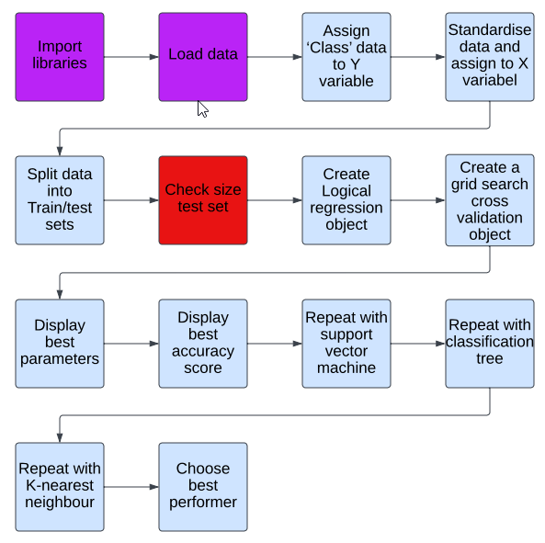
Predictive Analysis (Classification)
Mission Data were prepared as input and output variables and split into training and test data.
Data was fit to different ML strategies
Best parameters were found using cross-validation grid search
https://github.com/Tex6298/SpaceY/blob/main/Lab_6_Machine_Learning_Prediciton_Lab.ipynb

Slide 17
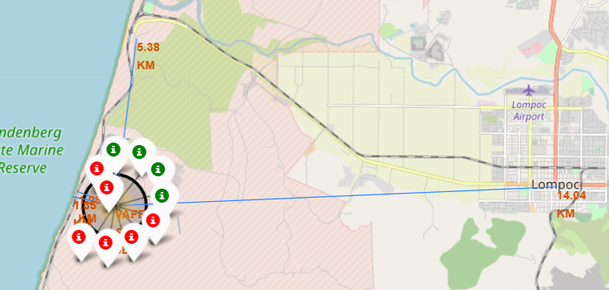
Results
Average success rate 0.66, Success rate improved year on year,
ES-L1, GEO, HEO & SSO missions had 100% success rate
LEO success rate improved with time while there is no evidence of improvements for GTO
Heavy payloads was correlated with higher success rate but not for GTO
No heavy payload missions were launched from VAFB-SLC launch
All predictive models were very good with an accuracy between 0.85 and 0.9
Best predictive analysis results were from classification tree method with an accuracy of 0.889

Slide 18

Section 2

Slide 19
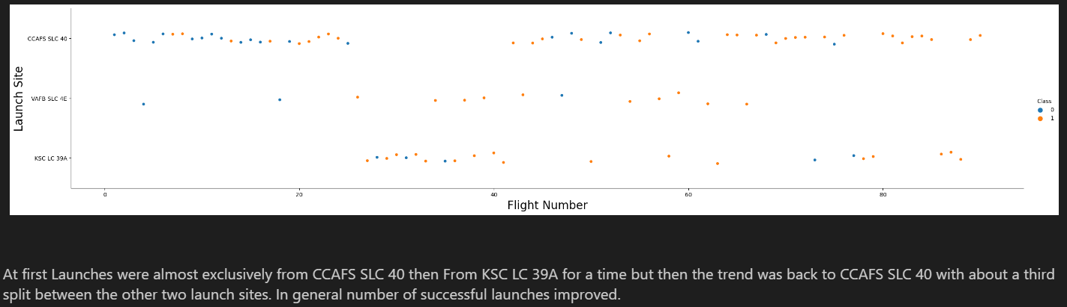
Flight Number vs. Launch Site
Scatter plot of Flight Number vs. Launch Site

Slide 20
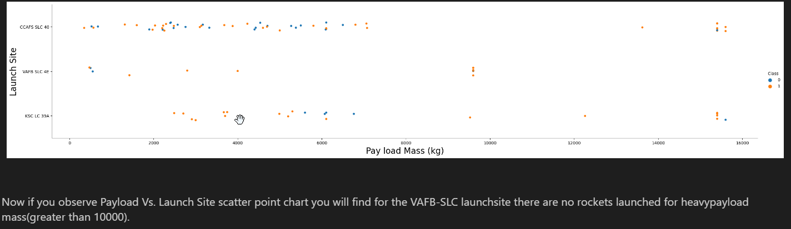
Payload vs. Launch Site
Scatter plot of Payload vs. Launch Site

Slide 21
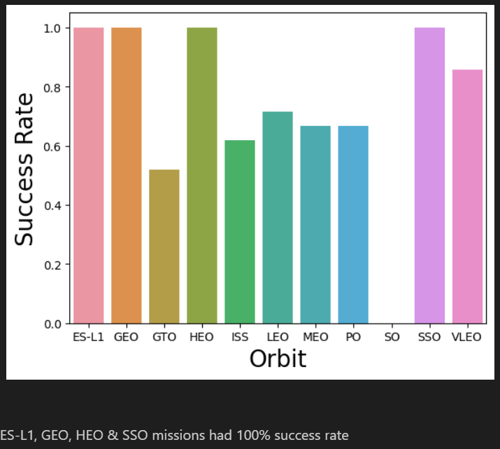
Success Rate vs. Orbit Type
Bar chart for the success rate of each orbit type

Slide 22
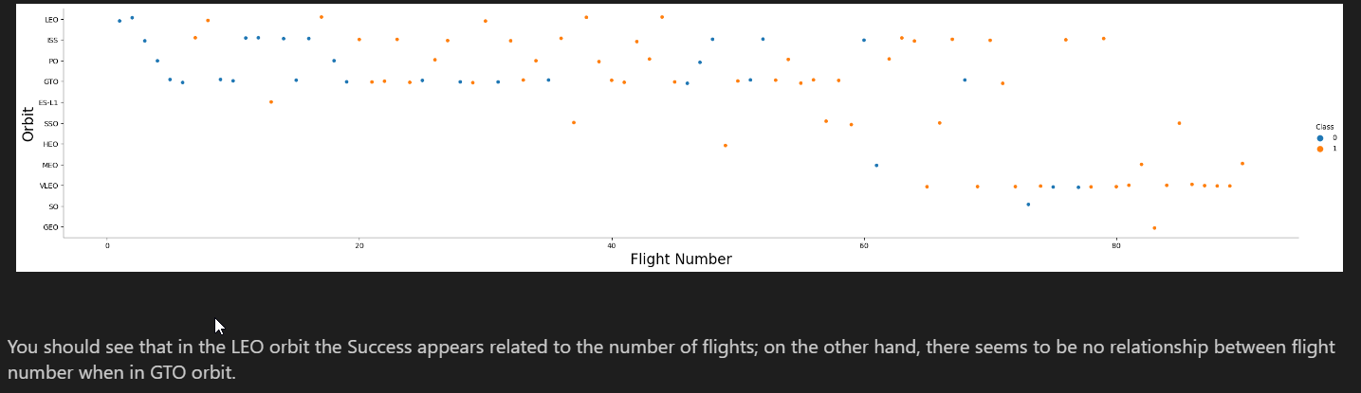
Flight Number vs. Orbit Type
Scatter plot of Flight number vs. Orbit type

Slide 23
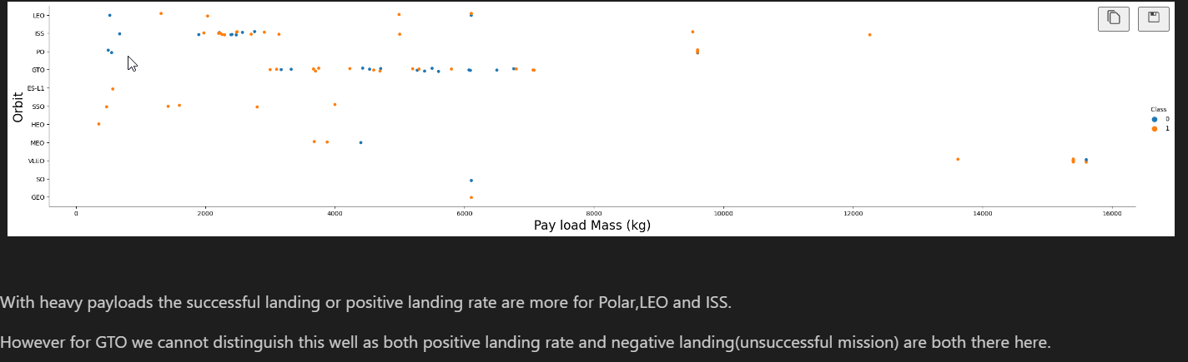
Payload vs. Orbit Type
Scatter plot of payload vs. orbit type

Slide 24
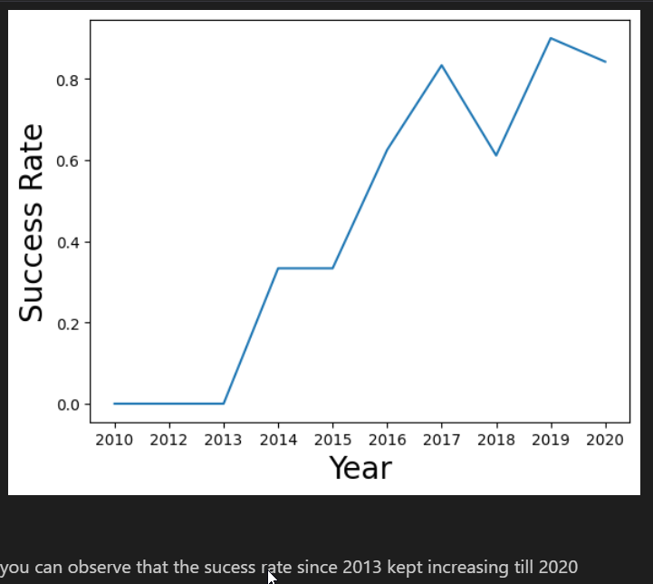
Launch Success Yearly Trend
Line chart of yearly average success rate

Slide 25
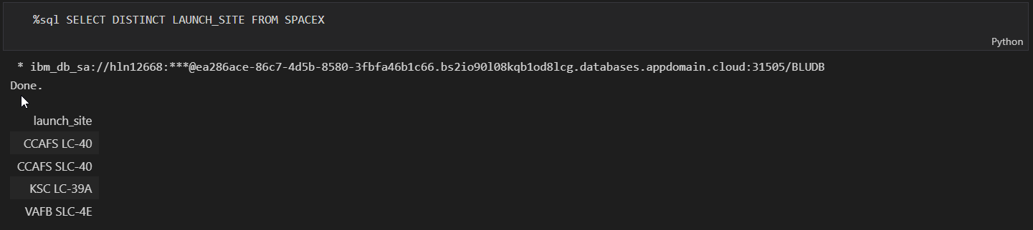
All Launch Site Names
SQL query was used to list the individual launch site names.

Slide 26
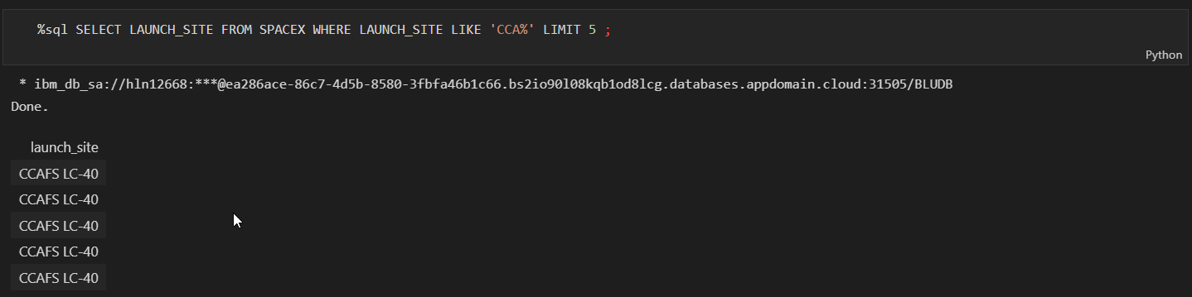
Launch Site Names Begin with 'CCA'
5 results were called using the LIMIT function

Slide 27
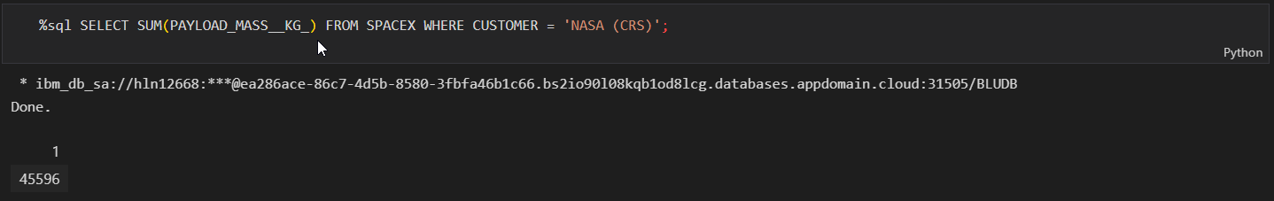
Total Payload Mass
Total payload mass was calculated using the SUM() function.

Slide 28
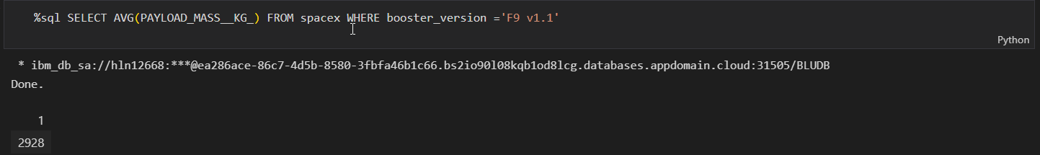
Average Payload Mass by F9 v1.1
Average payload of F9 v1.1 booster with the AVG() function

Slide 29
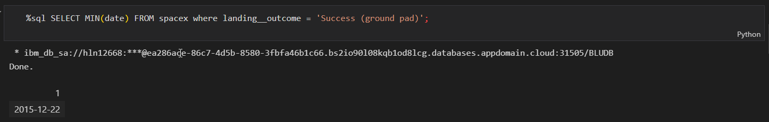
First Successful Ground Landing Date
First successful landing listed using MIN() function on the date column

Slide 30
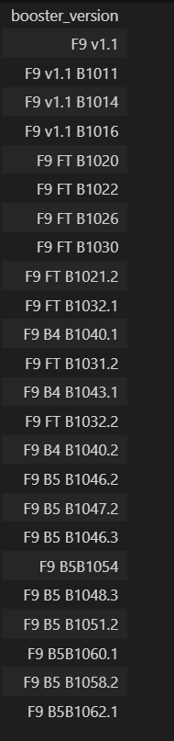
Successful Drone Ship Landing with Payload between 4000 and 6000
The names of boosters which have successfully landed on drone ship and had payload mass greater than 4000 but less than 6000
Payload range was defined using the WHERE modifier

Slide 31
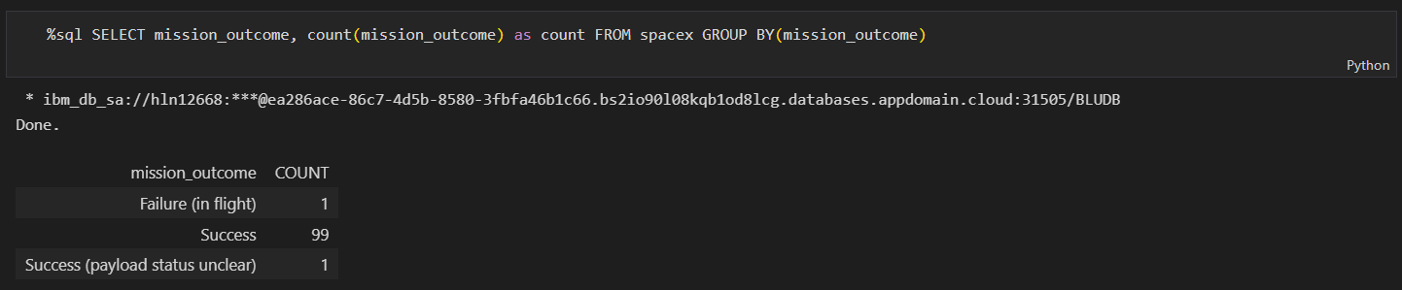
Total Number of Successful and Failure Mission Outcomes
Total missions listed by outcome we listed using the Group By query

Slide 32
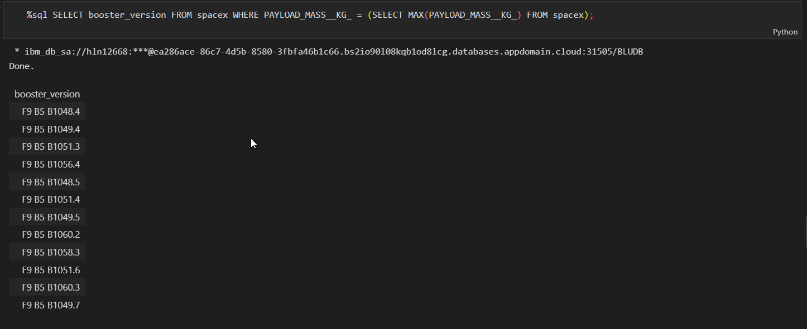
Boosters Carried Maximum Payload
Boosters that carried maximum payload listed using a subquery

Slide 33
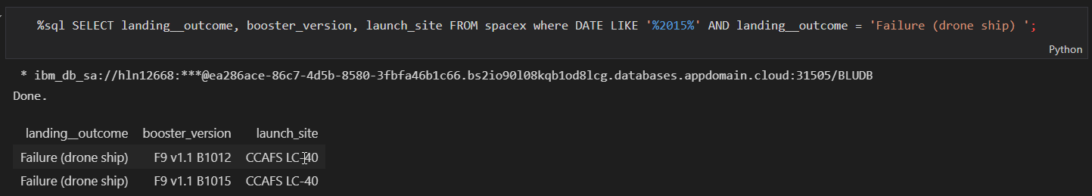
2015 Launch Records
2015 launch records were found querying a combination of LIKE and % wildcard symbol

Slide 34
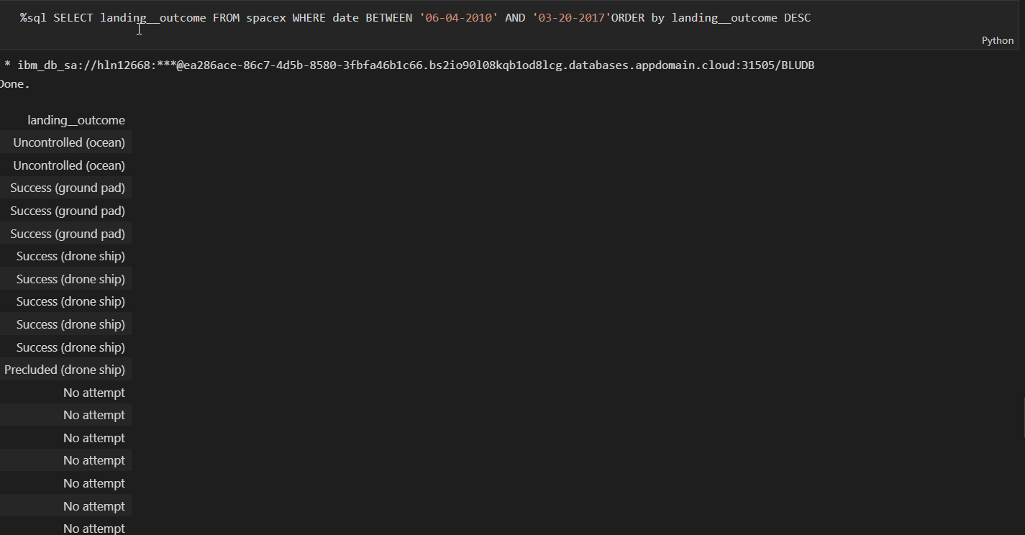
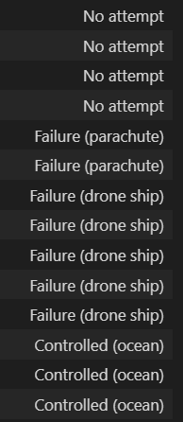
Rank Landing Outcomes Between 2010-06-04 and 2017-03-20
Landing outcomes range was listed using the BETWEEN and were ranked using DESC and ORGER BY query calls

Slide 35

Section 3

Slide 36
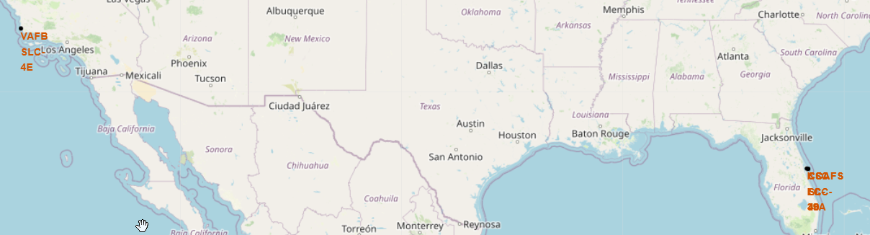
all launch sites on a map
Launch sites are located on far coasts and to the south
Two are too close together to read in a zoomed out map

Slide 37
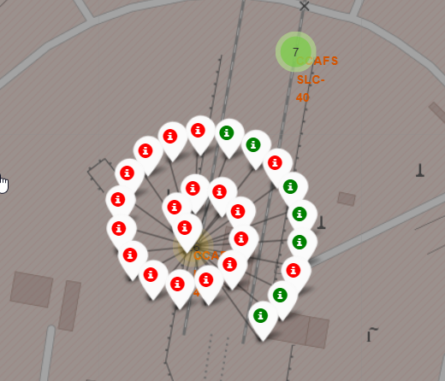
success/failed launches
Success/failed missions were colour coded and marked using a marker cluster, clicking on the launch site shows the individual missions in red for failed or green for successful

Slide 38
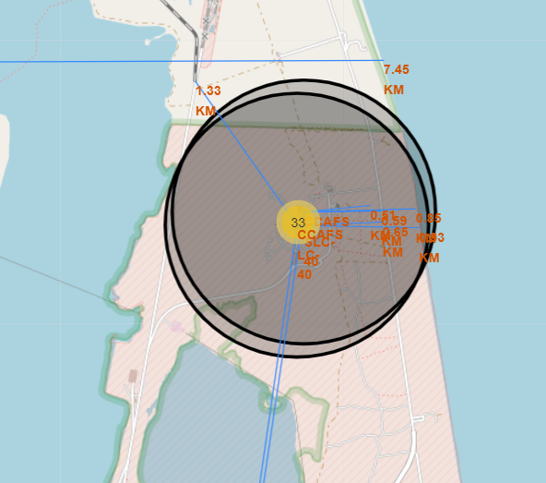
Distance to Important Features from Launch Site
Lines and distance of feature to launch site were marked on the map
Launch sites are between 0.5-1.5km from railways.
Launch sites are between 0.6-5km from highways.
Launch sites are between 0.8-8km from coastline.
Launch sites are more than 14km from cities.
Railways and highways are probably useful to have nearby for logistics.
Proximity coastlines probably has to do with the weather/atmosphere and removing a direction hazards can leave or approach a launch site.
Keeping launch sites away from cities is definitely a safety and pollution consideration.

Slide 39

Section 4

Slide 40
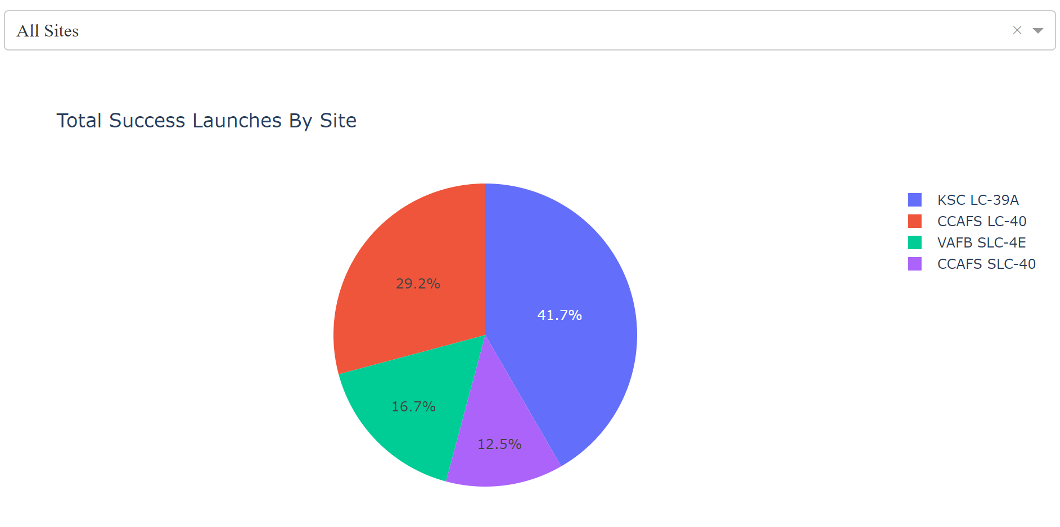
Percentage of Successful Launch by Launch Site
The Pie chart shows that most of the successful launches were from KSC LC-39A

Slide 41
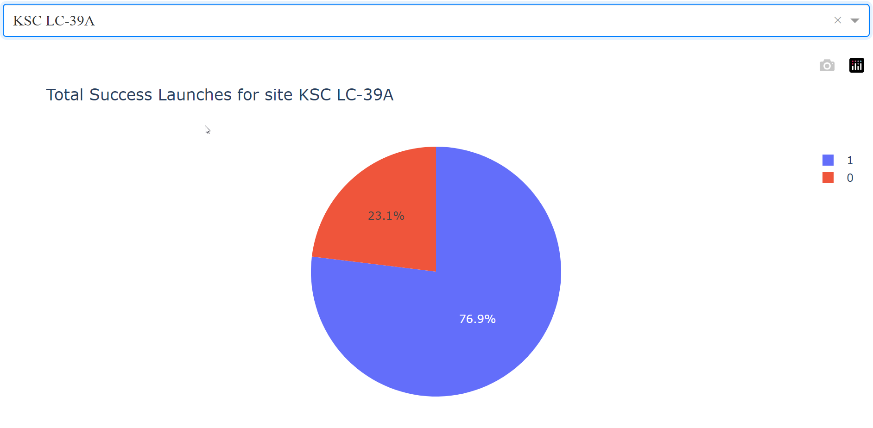
Percentage of Successful Launches from KSC LC-39A
The site with the most successful launched has a 76.9% success rate

Slide 42
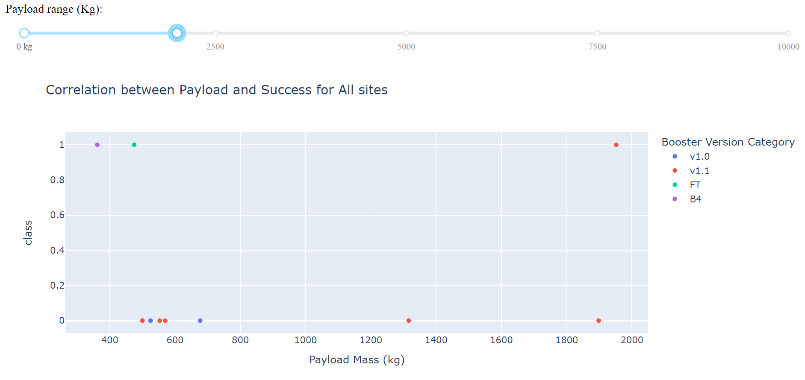
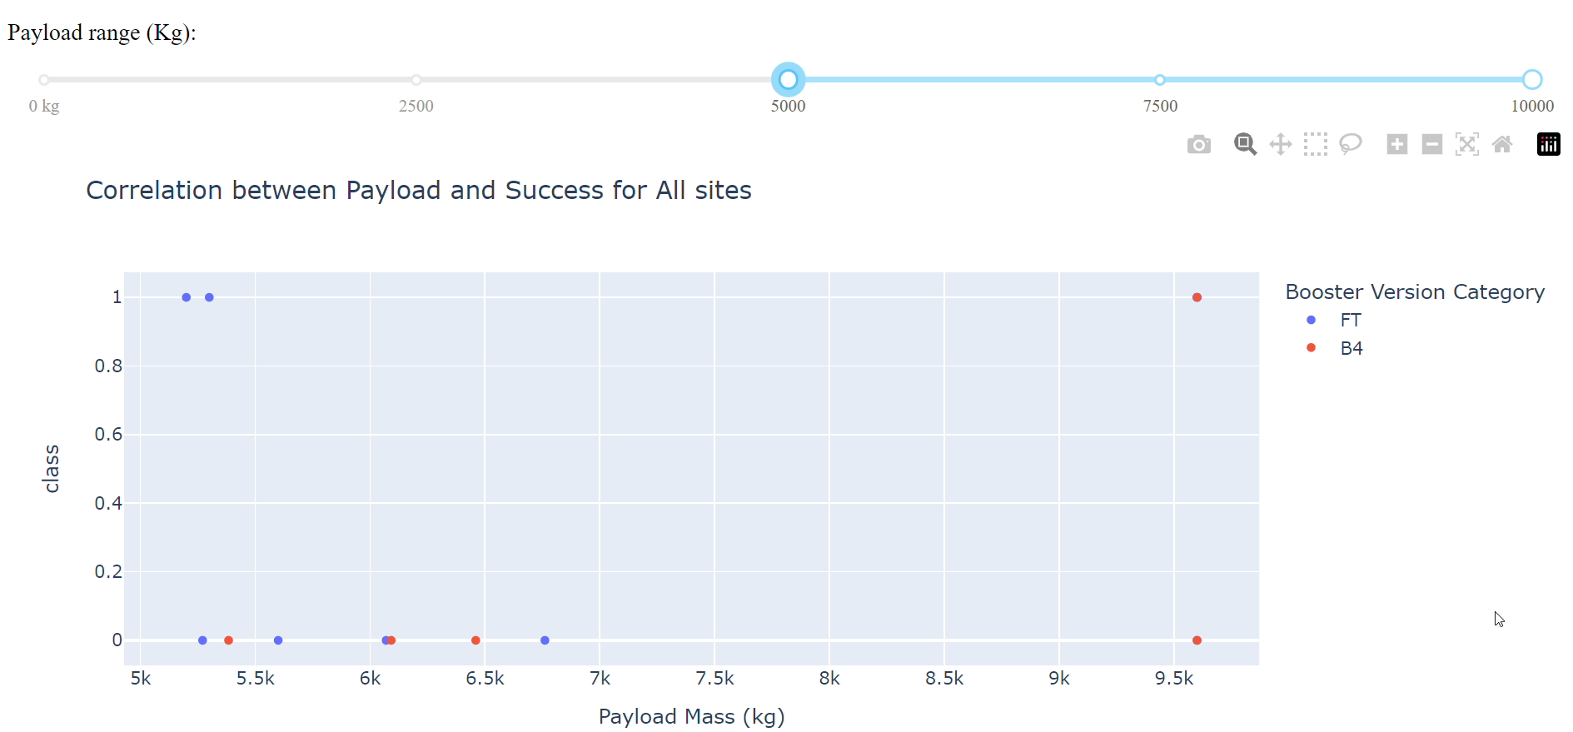
Effect of Payload and Booster on Mission Success
In the high payload range the result was less dependent on the type of rocket than in the low payload range where you see some rockets were only failures and other were almost entirely successful

Slide 43

Section 5

Slide 44
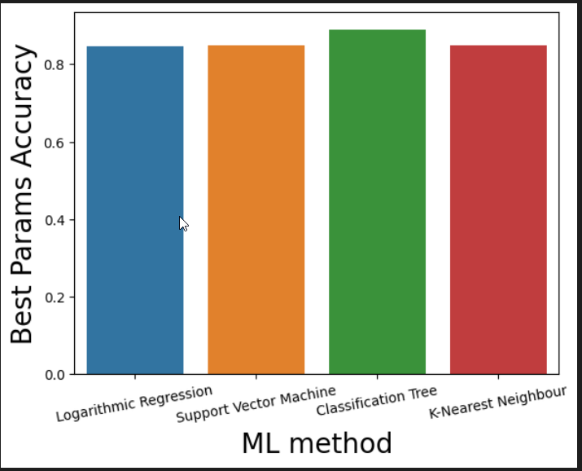
Classification Accuracy
Tree classifier model has the highest classification accuracy

Slide 45
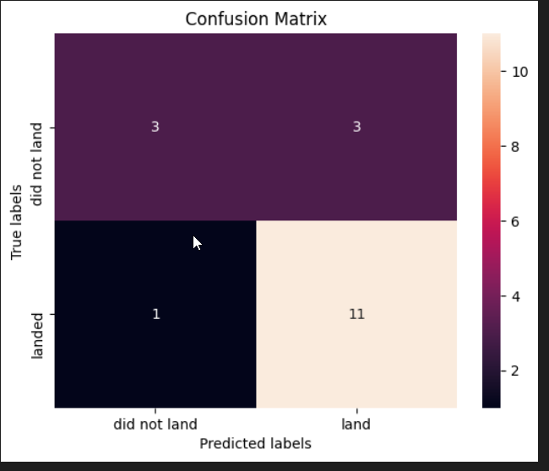
Confusion Matrix
Confusion matrix shows how our tree classifier model does against a test set not used in training
11 true positives
3 true negatives
3 false positives
1 false negative

Slide 46
Conclusions
High payloads result in more successful missions.
KSC LC-39A is the best launch site with most successful missions.
Classification tree can be used to predict successful missions for maximum profits as teams get better and knowhow integrates over the work culture
Mission success increases over time

Slide 47
Appendix
This snippet of code was particularly helpfu for drawing multiple features on the folium maps:
https://github.com/Tex6298/SpaceY/blob/main/shiproadrail.py

Slide 48


